Slide 1
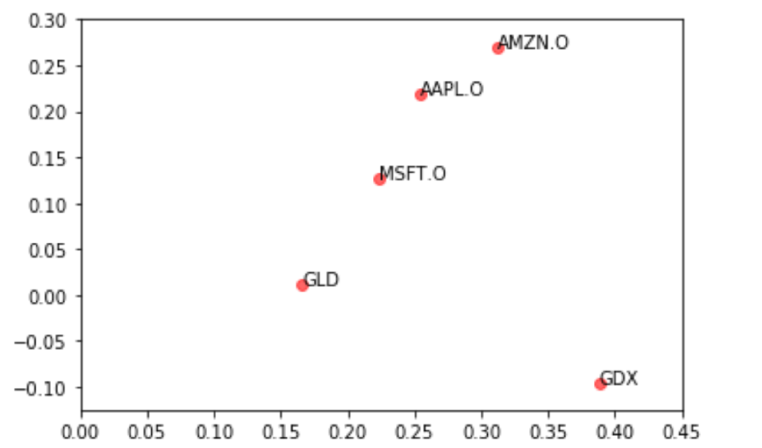
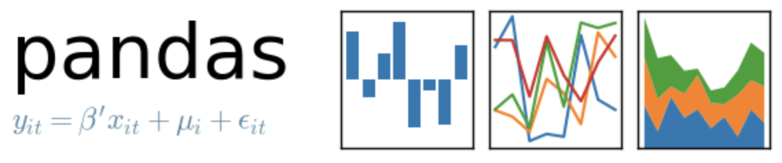
Portfolio Optimization
-
Risk Return Plot

Slide 2
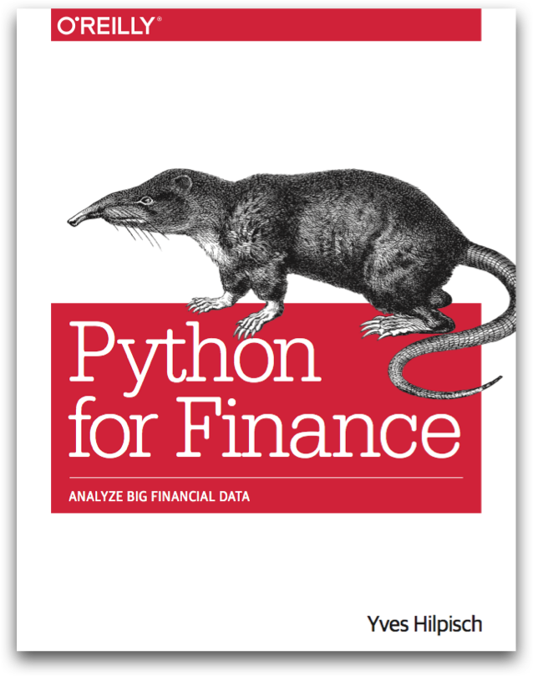
Reference
Chapter 11 of Python for Finance (O'Reilly)
Data
Youtube
Code

Slide 3
Data Loading

Slide 4
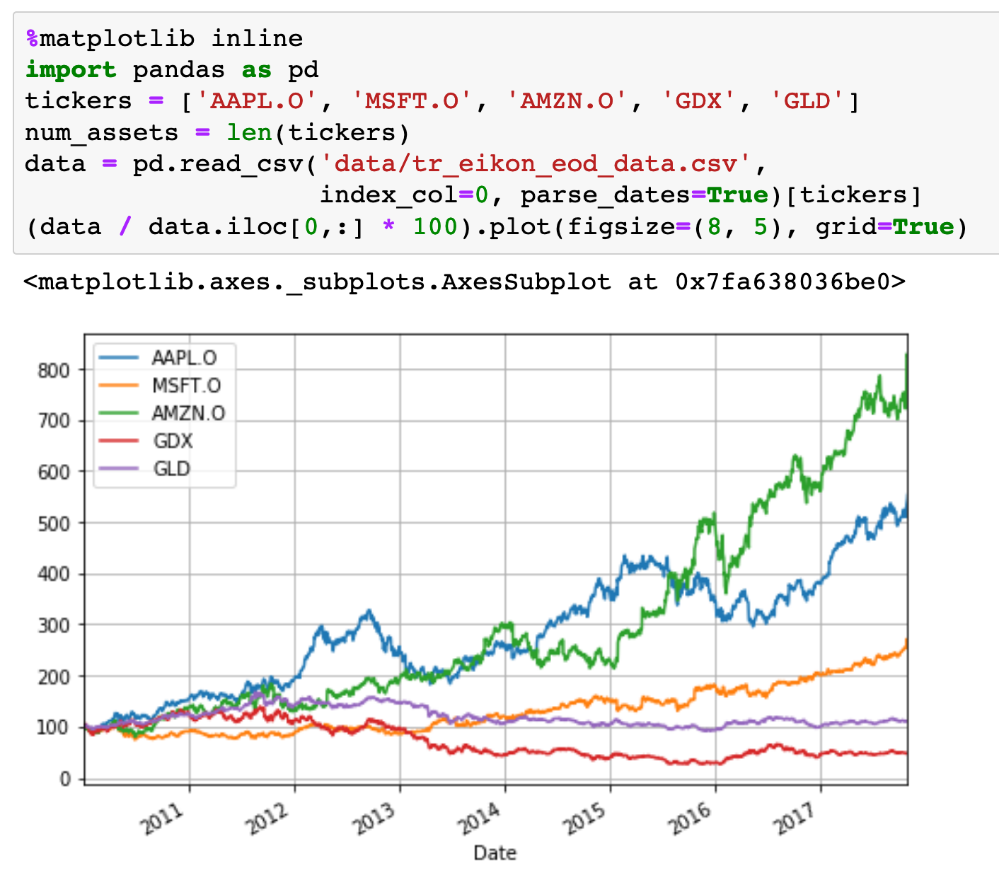

Slide 5
Data

Slide 6
Computation
of
Mu and Sigma

Slide 7
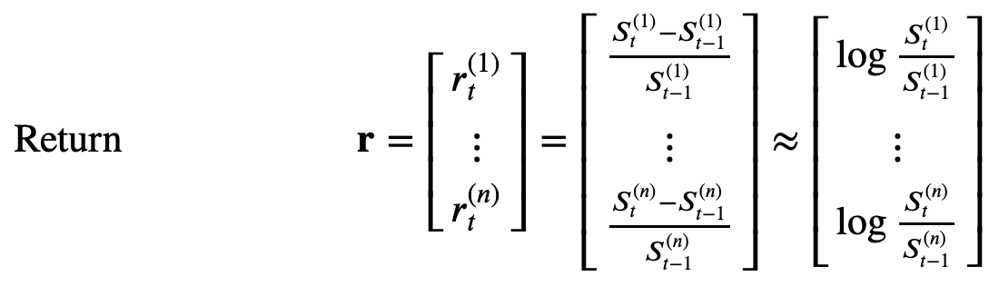

Slide 8
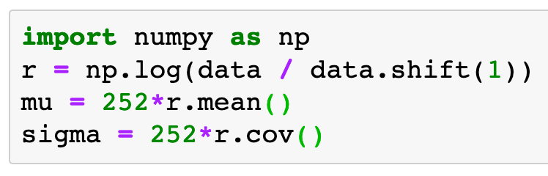

Slide 12
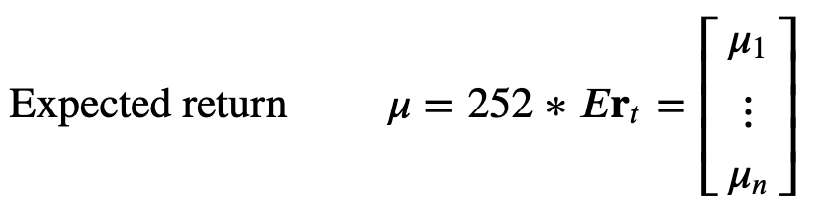

Slide 16
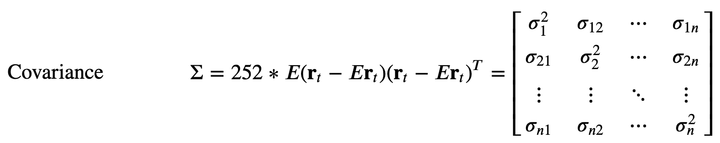

Slide 20
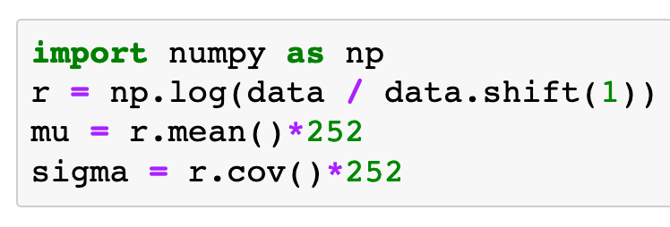

Slide 21
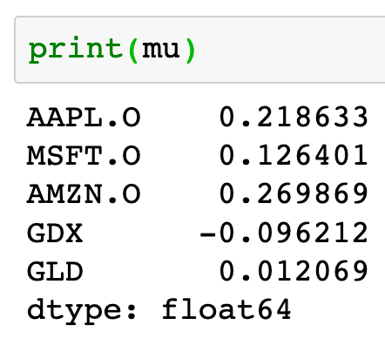

Slide 22
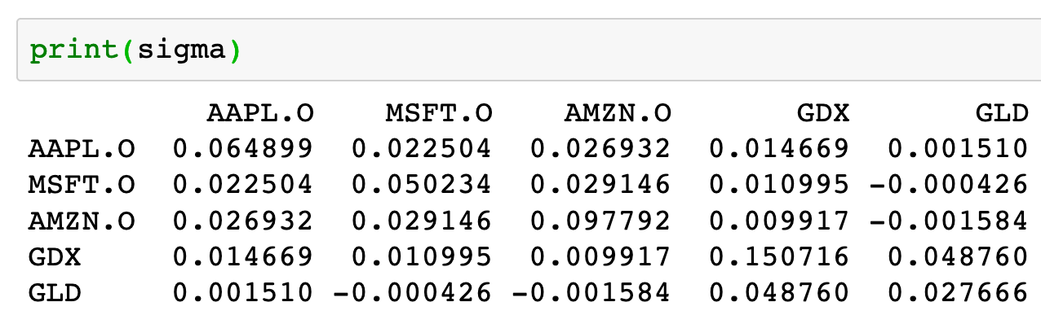

Slide 23
Risk-Return Plot

Slide 24
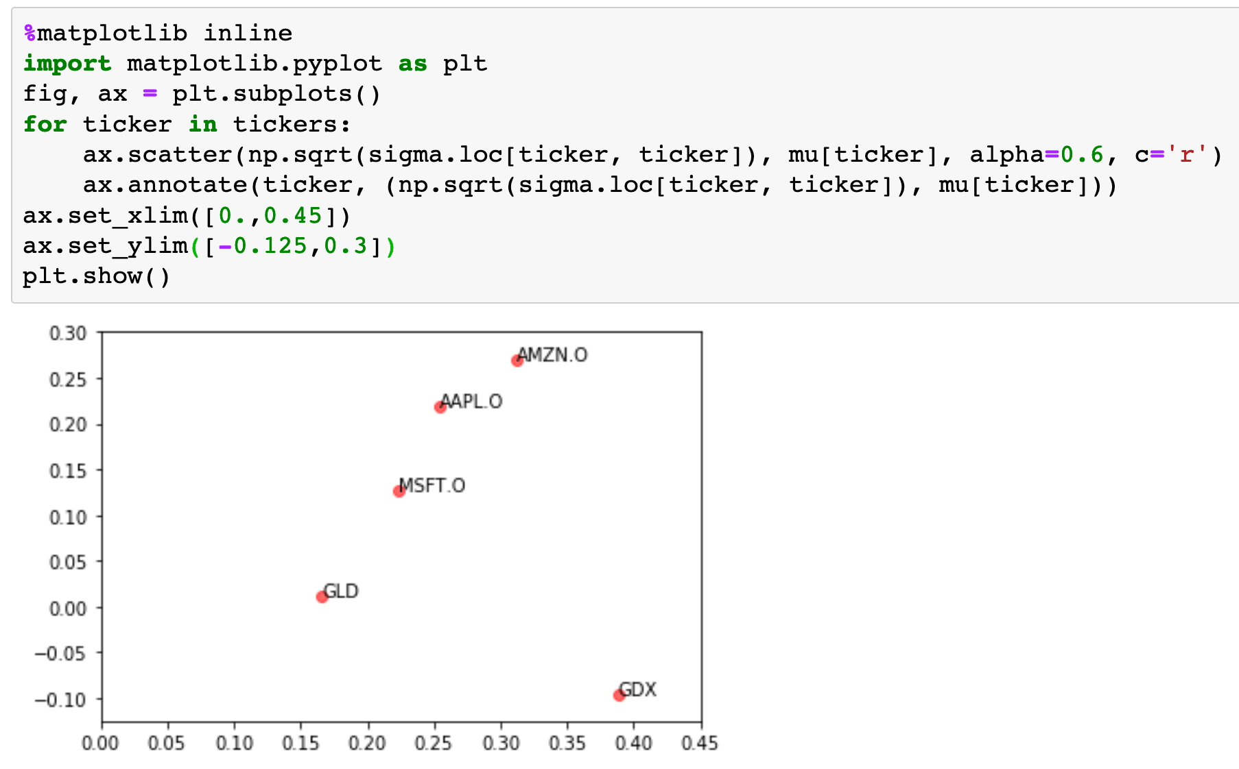

Slide 25
Import Module

Slide 26
Import Module
OOP Style Subplots

Slide 27
Import Module
OOP Style Subplots
Show

Slide 29
Scatter Plot

Slide 30
Risk
Scatter Plot

Slide 31
Risk
Return
Scatter Plot

Slide 32
Annotate

Slide 33
Ticker
Annotate

Slide 34
Ticker
Ticker Location
Annotate

Slide 35
Set xlim

Slide 36
Set xlim
Set ylim

Slide 37
Copy
Original
Tickers, Mu and Sigma

Slide 38
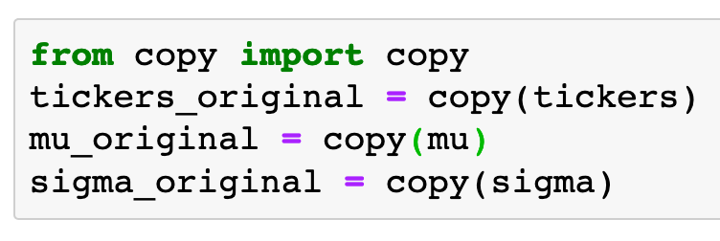

Slide 39
Now
Let’s Play with Code

